Slide 1

Domino’s Live Project
Dr. Upender’s Class: Team 2
Aditi Ramadurgakar
Akshay Kothari
Jagruthi Budda
Meenakshi Nayak
Rohit Sarkar

Slide 2
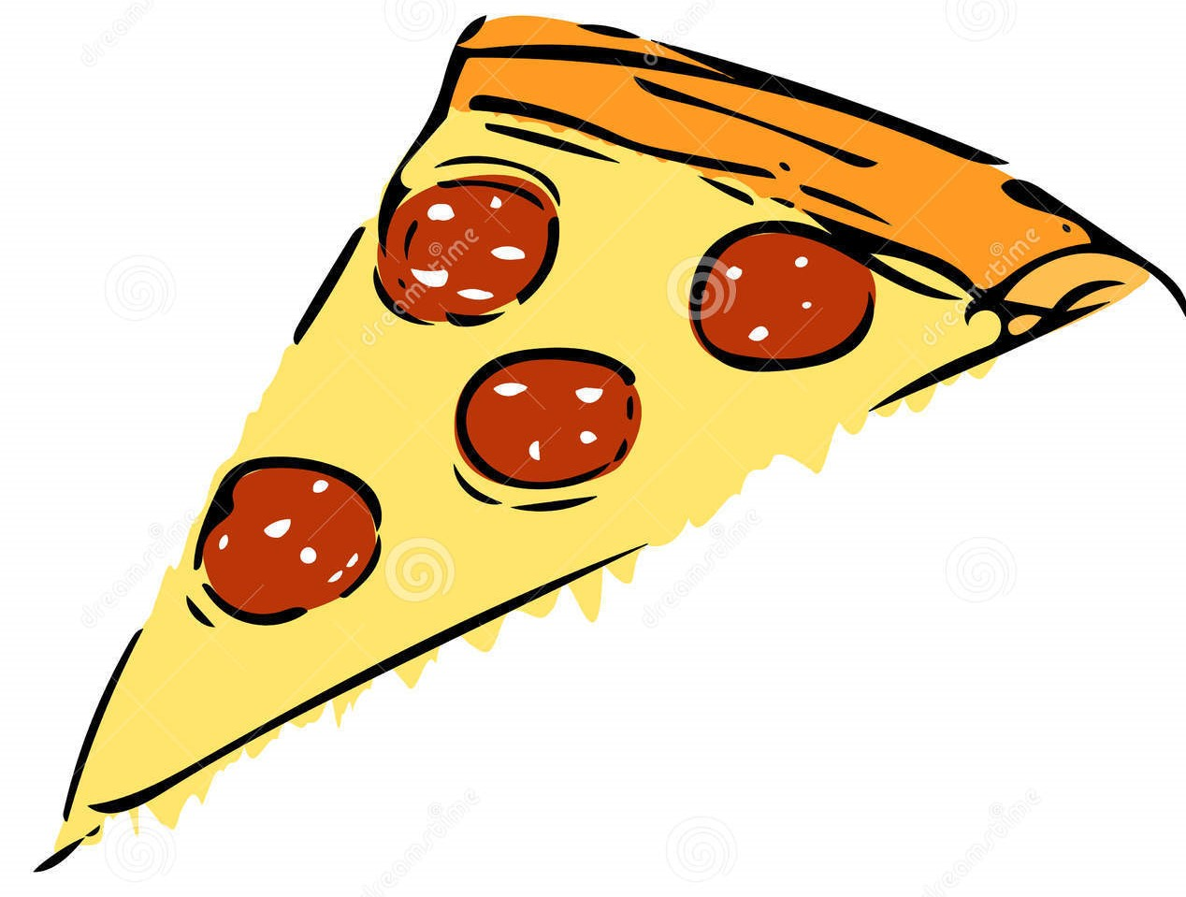
OBJECTIVE
Most used and effective coupons/offers?
Offers relevant to run?
Offers most effective to send to each household?
Approach: Customer Profiling

Slide 3
GROUP PROFILING
5 categories as per the average discount amount and ranked according to the individual group characteristics
Highest percent of transactions: High discounted coupons
Lowest percent of transactions: Under discounted coupons
Low, Medium and Over discounted coupons have almost equal number of transactions

Slide 4
GROUPING BY AVG % DISCOUNT

Slide 5
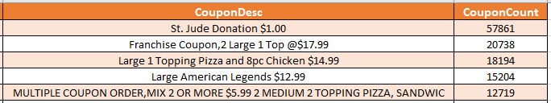
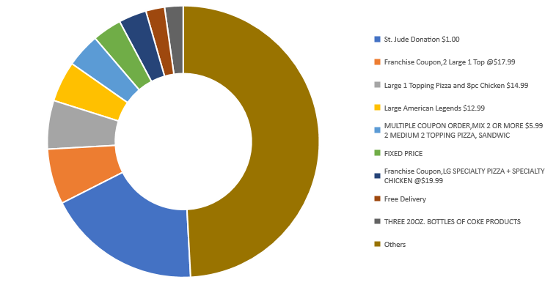
% of COUPON TRANSACTION - Under Discounted

Slide 6
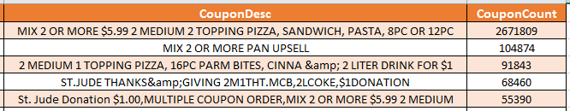
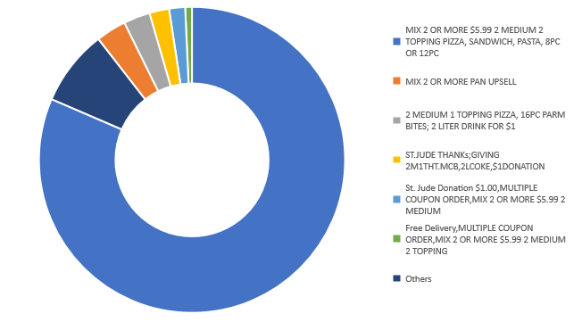
% of COUPON TRANSACTION - High Discounted

Slide 7
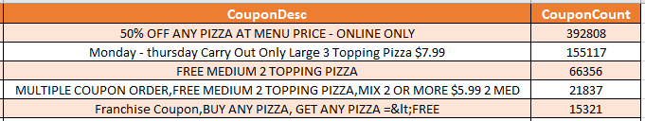
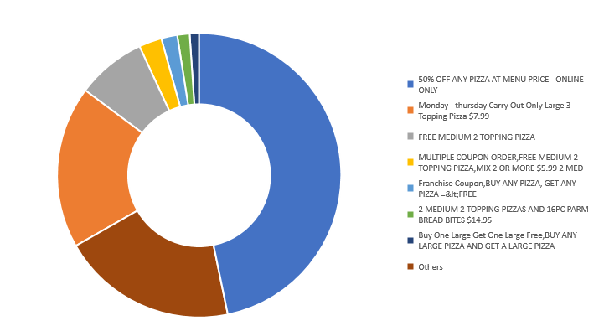
% of COUPON TRANSACTION - Over Discounted

Slide 8
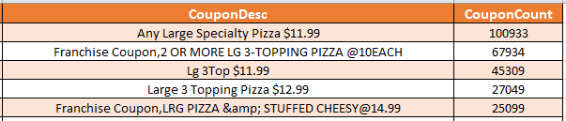
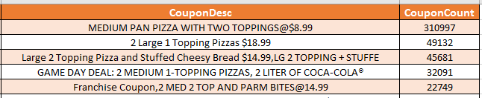
Top 5 Used Coupons in Other Discounted Categories
Low Discounted
Mid Discounted

Slide 9
DISCOUNT WISE INFERENCES
Maximum number of coupons are sold during dinner meal.
Medium discounted coupons are used mostly on late night meals.
Lunch meal is not significantly affecting the discounted amount for the coupons.

Slide 10
DISCOUNT WISE INFERENCES
Low discounted and medium discounted coupons are used from Thursday through Saturday.
High Discounted coupons are always preferred.
Over Discounted is used on weekdays in comparison to other discounts.

Slide 11
DISCOUNT WISE INFERENCES
Behavior of groups with high and low purchasing power of income is exactly opposite.
Low Discounted coupons are preferred by both groups.
If purchasing power of income is high people are not going for high discounted coupons.

Slide 12
DISCOUNT WISE INFERENCES
Age4to7 & Age8to12 are preferring coupons which are highly discounted
Age13to17 are preferring Over Discounted coupons rather than High Discounted coupons.

Slide 13


OTHER INFERENCES
 | Under Discounted | Low Discounted | Medium Discounted | High Discounted | Over Discounted
Side Order
Pi Count
Topping Count
Bread Count

Slide 14
RECOMMENDATIONS
Coupons in the over discounted coupons categories with less frequency count and high percentage discounted amount should be dropped.
As coupons are mostly used during the dinner meal, new coupons should be introduced in those time periods.
During late-night meals, the high discounted and mid discounted coupons should be given more as compared to the other groups.
During weekdays, the over discounted coupons should be provided more whereas during weekends including Friday, the low and mid discounted coupons should be provided to the new customers.
Customers with high purchasing power income should be given low discounted coupons whereas low purchasing power income should be given high discounted coupons.
Families with children below 13 yrs. should be given mid discounted and high discounted coupons whereas families with children between 13- 17 yrs. should be given over discounted coupons.
Over discounted coupons should be offering discounts on the pie counts whereas low discounted and mid discounted coupons should be offering side-orders.
High discounted coupons should be offering deals with pie count and topping count.

Slide 15
CLUSTERING
Offers are divided into 3 clusters randomly based on –
Order type(Ph/Web)
Household
Associated costs with order (menu/discount etc)
Count of bread, pie, topping, side orders if any
Meal period(lunch/dinner/late night)
Cluster 3 is insignificant - not used for analysis
Cluster 2 has highest frequency count

Slide 16
CLUSTERING
Cluster with non frequent customer has higher topping and pie count

Slide 17
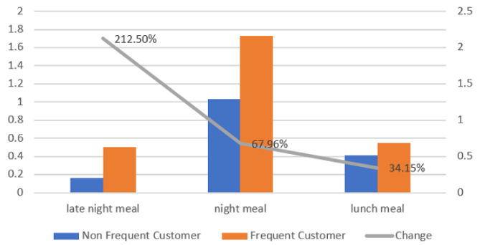
CLUSTERING

Slide 18
FUTURE PLAN
1
Logistic regression on the clusters to determine significant demographics and transactional factors in that cluster considering the coupon profiling
2
Run the model through all 4 transaction datasets - oct-2015 to sep-2016
3
Yearly analysis, seasonal analysis on different significant factors
Coupons to recommend to different households, using demographics and mailed dataset
4

Slide 19
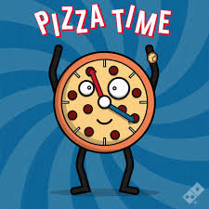
Thank You!
Any Questions?

